Slide 1

Lecture7:
Introduction and natural resources
(Energy resources: Renewable and non renewable energy sources, use of alternate energy sources, growing energy needs, case studies)

Slide 2
Learning outcomes
After completing this lecture, you will be able to understand the following:
Student will get knowledge about importance and benefits of energy resource.
Student will understand the importance of alternative energy resources.

Slide 3
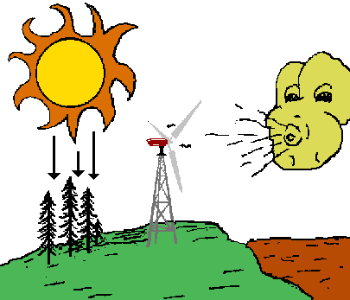
Energy Resources
All living creatures on the earth, either it is a plant, an animal or a microbe need energy to perform their vital functions. The earth is a storehouse of energy. The fossil fuels under its surface, the wind and water on its surface, the plants growing on it, the sunlight falling upon it, these are all sources of energy.

Slide 4
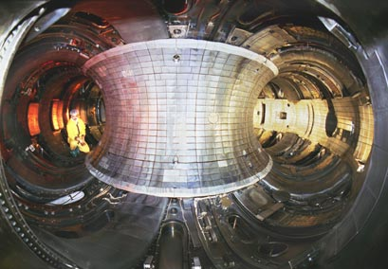
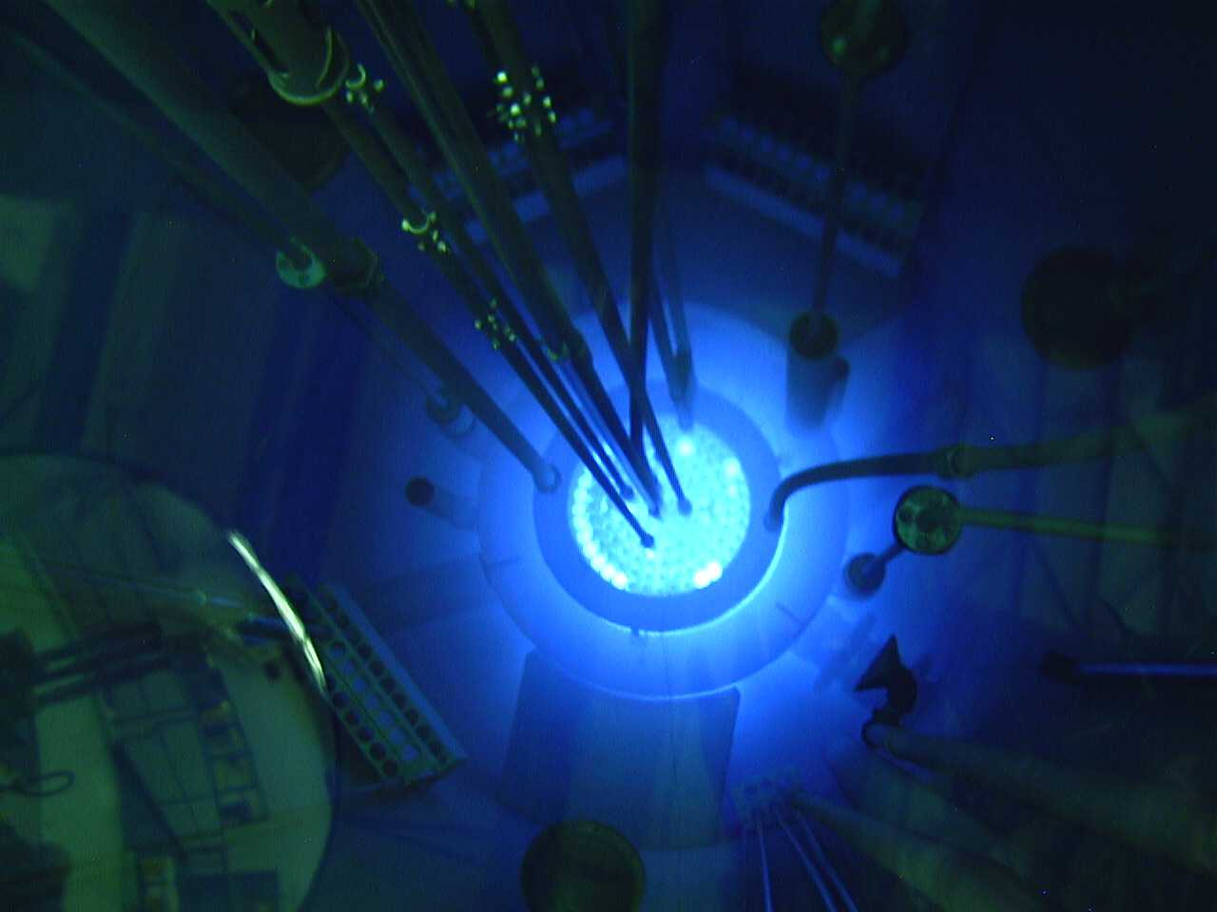
Potential Sources of Energy when
Fossil Fuels Run Out
Magnetic Plasma Confinement,
Inertial Fusion
Nuclear Fusion
Waste &
Nuclear Proliferation
Nuclear Fission
10 TW = 10,000 new 1 GW reactors: i.e., a new reactor every other day for the next 50 years

Slide 5
Renewable Sources of Energy Non Renewable Sources of Energy
Solar Energy Coal
Wind Energy Natural Gas and Oil
Tidal Energy Nuclear Energy
Geothermal Energy
Biomass Based Energy

Slide 6
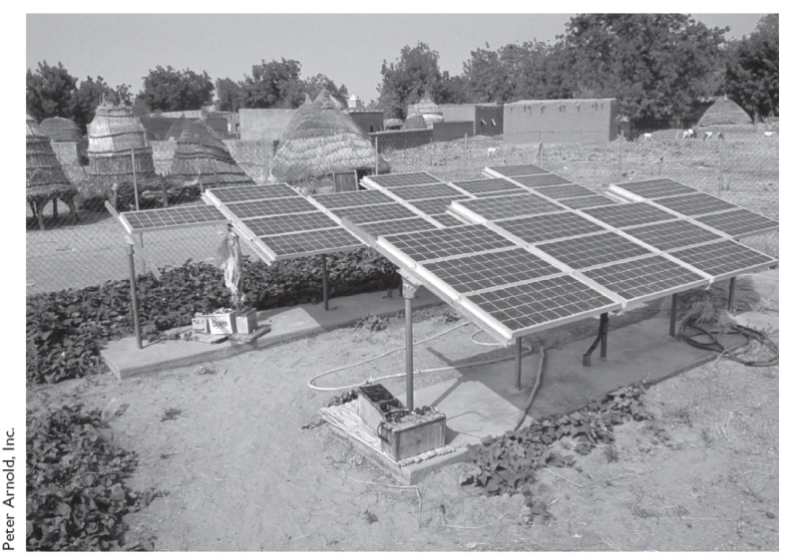
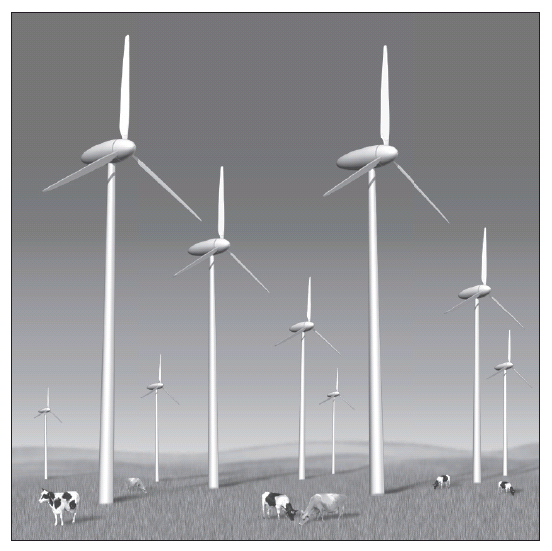
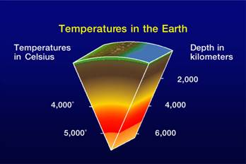
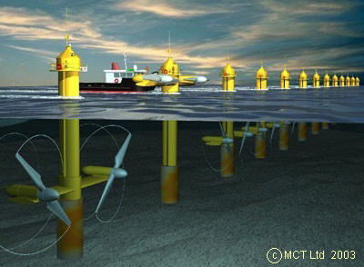
Renewable Sources of Energy
Solar Energy
Wind Energy
(India’s potential approx
20,000 MW)
Tidal Energy
Geothermal Energy
Biomass Based Energy (Natural vegetation,
animal waste)

Slide 8
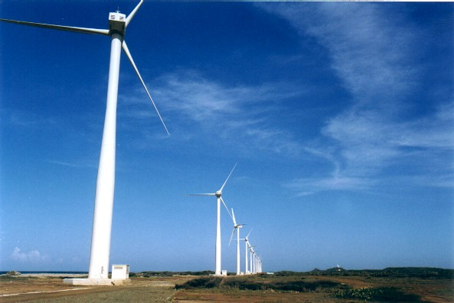
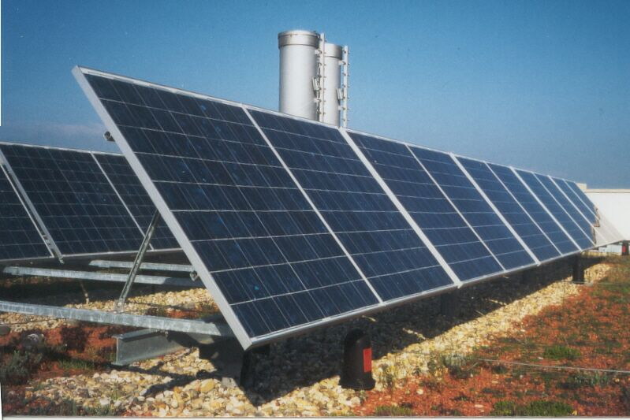
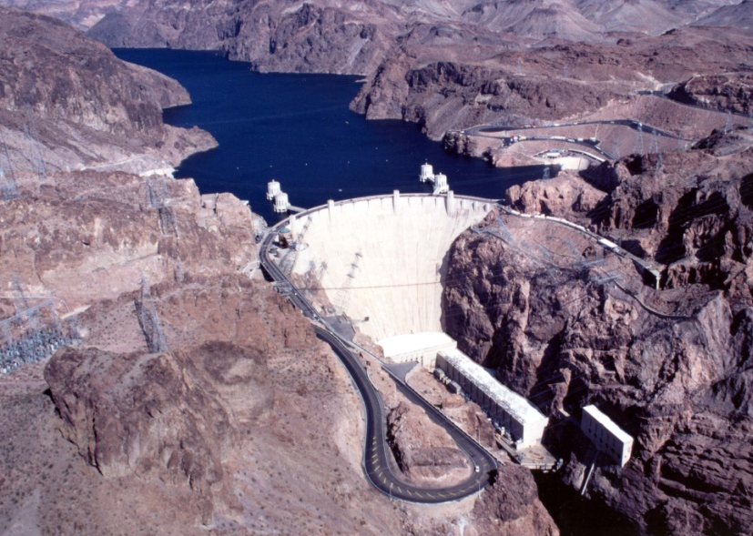
Solar, Wind and Water
We do not know how to store electrical energy on a massive scale
Notes:
Nature has been converting sunlight, CO₂ water and nutrients into chemical energy for billions of years.

Slide 9
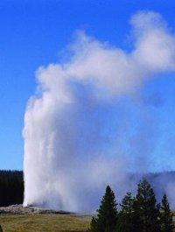
Geothermal
Heat near surface of the earth = geysers, volcanoes, hot springs

Slide 10



Solar to Chemical Energy
CO
O
H
2
2
2
e
e
Sugar
sc
M
sc
M
H O
2
H O
2
O
2
Photosynthesis
Semiconductor/
liquid junctions
Photovoltaic and
electricity to chemical

Slide 11
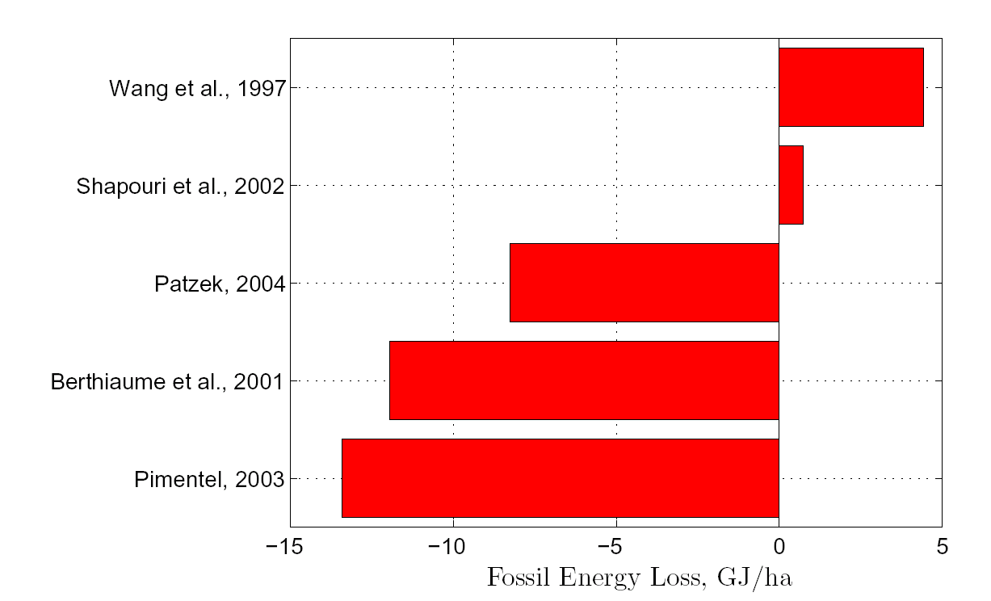
Energy gained in corn ethanol production

Slide 12
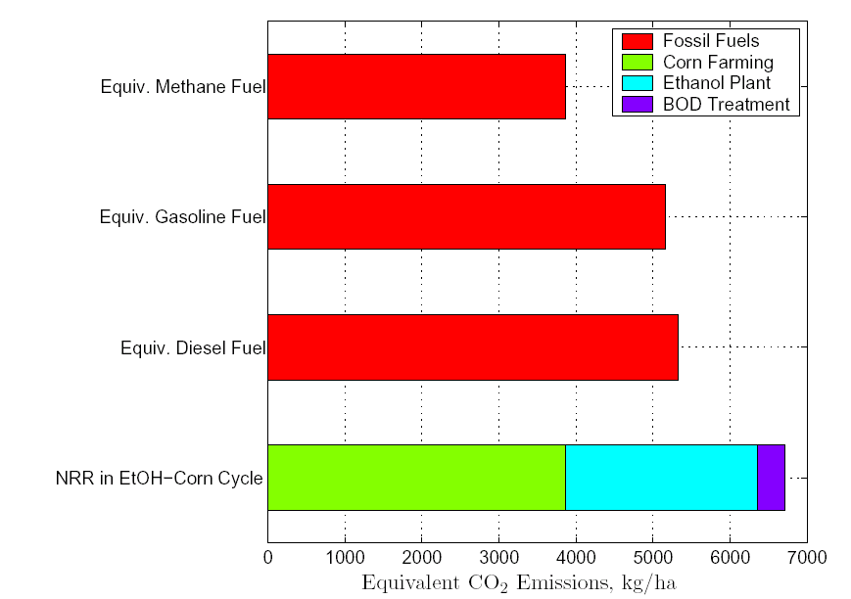
Total CO₂ emissions

Slide 13
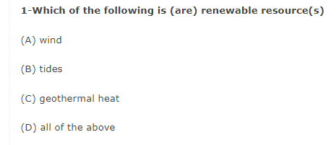

Slide 14
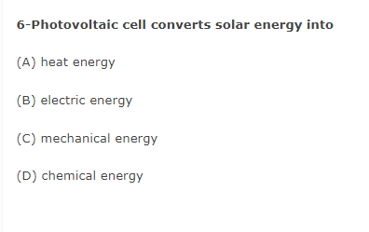

Slide 16
Problems with hydroelectric
Location = unused rivers are in extreme north or low population areas
Competition with recreational uses (U.S.) and environmental concerns
Hard to build dams in populated river valleys
Siltation of dams – limited life.

Slide 17
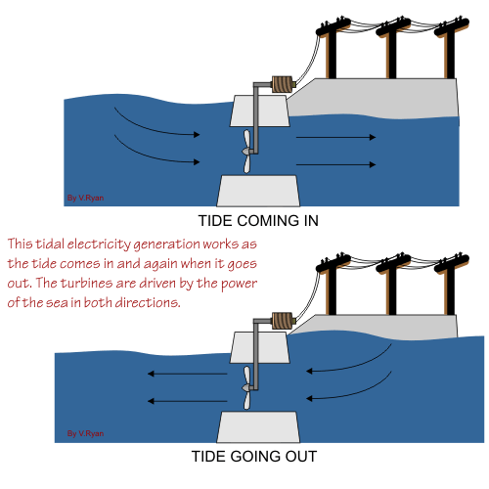
Tidal Power
In areas of large tides
Anywhere – build offshore dam

Slide 18
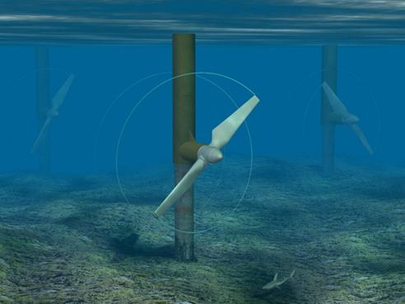
Tidal power anywhere
No dam – but a turbine.
Problems:
Corrosion
Navigation
Appearance
Amount of energy available is low
Best tides are near poles – away from people.

Slide 19
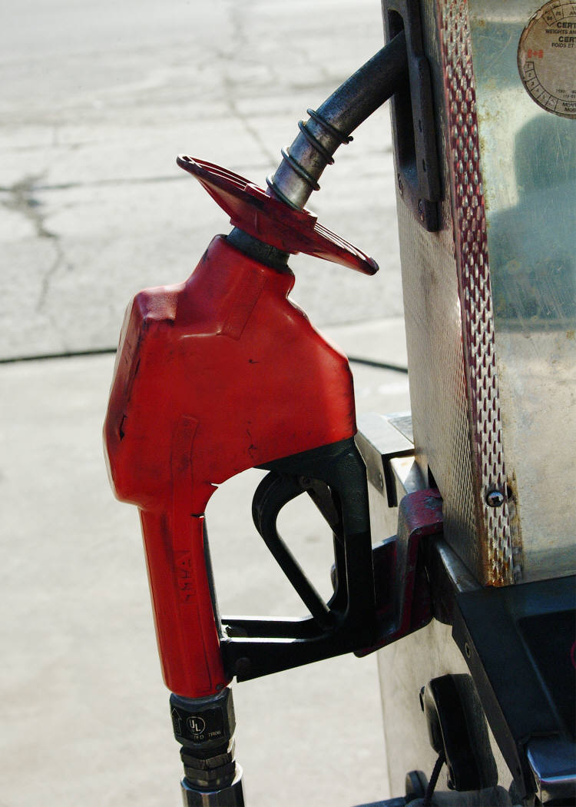

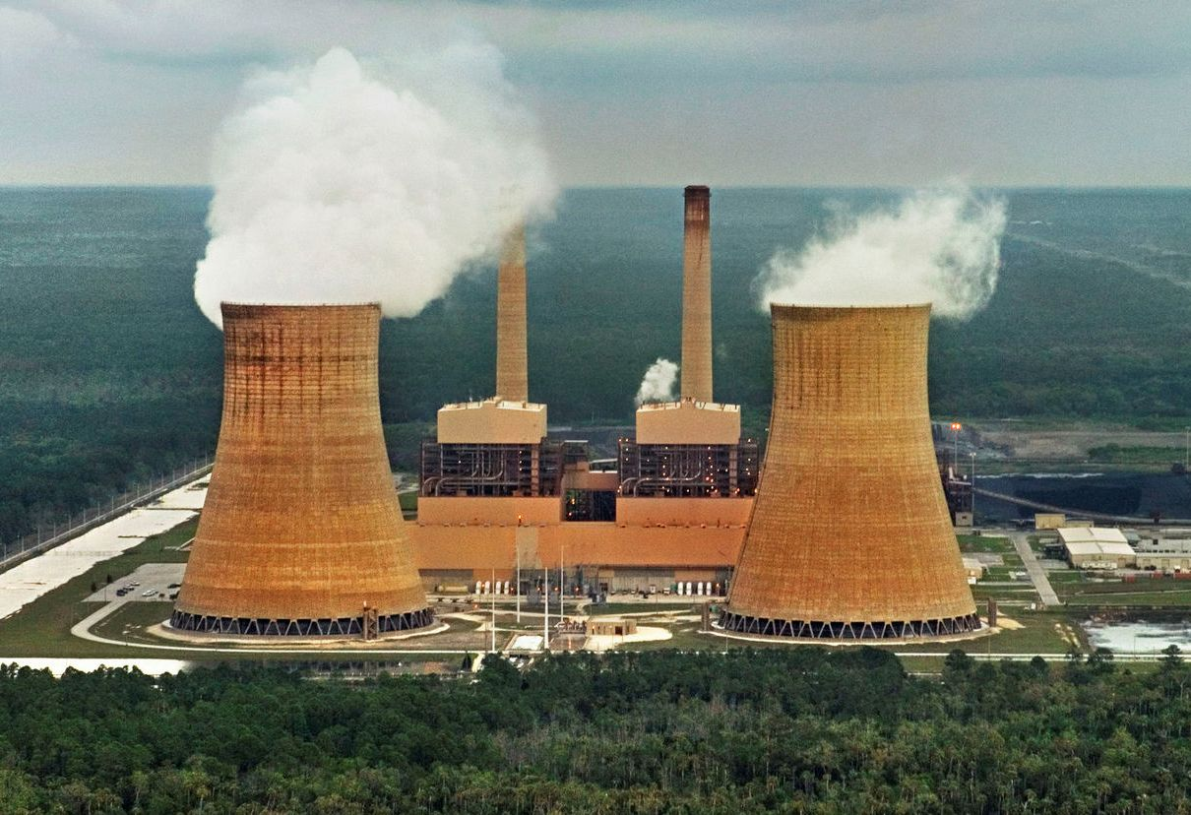
Non-Renewable Sources of Energy
Coal
Natural gas and oil
Nuclear energy (Controversial Because they use radioactive Substance but it does not emit any Green house gas or toxic gases.

Slide 20
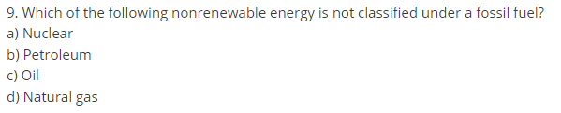

Slide 21
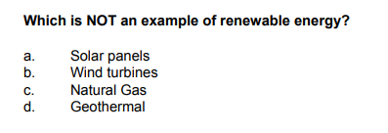

Slide 22
Use of Alternative Energy Sources
According to Integrated Energy Policy Report(IEPR) prepared by the planning commission aim is that at least 10% of the power generation installed capacity in the country should come from renewable source by the end of the 11th plan period.
India is now the world’s fourth largest generator of wind energy with an installed capacity of 7093 MW
India plan to manufacture biodiesel from inedible vegetable oils. The cost of setting up a biomass plant is the same as that of a coal based power plant

Slide 24
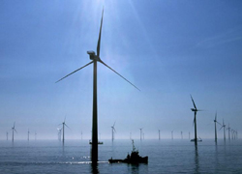
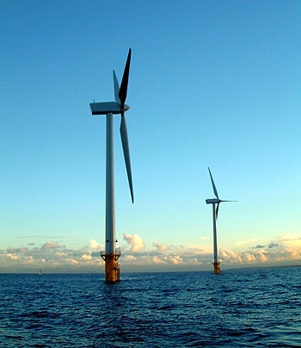
England = off shore

Slide 25
Wind energy problems
Location – near population center
Bird migration –
Visual
Must be coupled with other sources of electricity (intermittent supply)

Slide 26
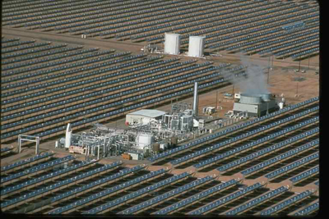
Solar Energy in More Details
1. Solar Thermal

Slide 27
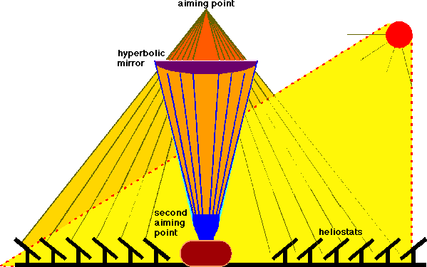
At focal point = heat liquid – steam to turn turbine

Slide 28
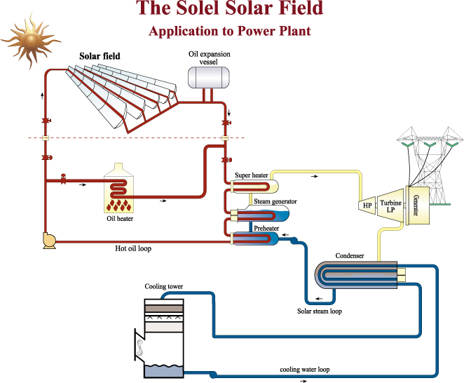

Slide 29
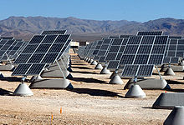
Big Plants

Slide 30
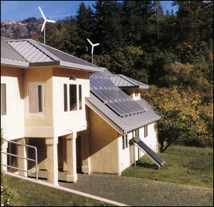
Decentralized
Energy efficient house; wind power on roof. Solar panels for heat and electricity.

Slide 31
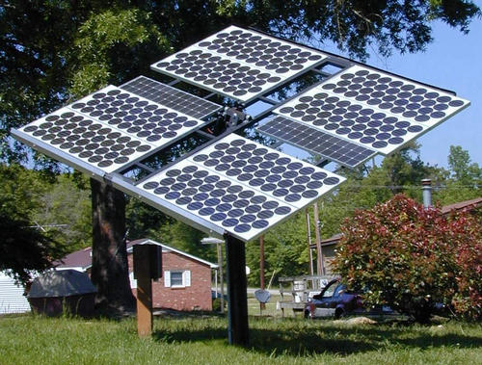
Solar electricity generation

Slide 32
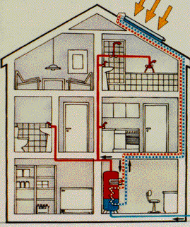
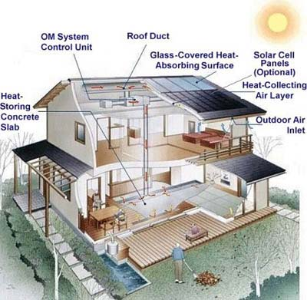
Solar water heating solar air heating

Slide 33
Limitations of Alternative Source of Energy
Most of the technologies involve high installation cost and require maintenance.
The material that find application in designing and manufacturing of device are not easily available. (Silicon example)
Weather problem.
Geographical problem.

Slide 34
Energy Recovery
The concept is to get energy by burning the waste
By this principle the main benefits what we can get –
Longer availability of crude oil.
Reduction of waste volume by upto 90%.
Reduced number of coal fired power plants.
Slow climate change.
Waste to energy plants (which is much advanced today) extract energy from trash
This plant reduces the emission of green house gases
Disadvantages-
Proper care must be taken on choosing the trash which is to be burn.
Indiscriminate burning may promote air pollution and may release toxic gases.
Combustion of heavy metals are very harmful.

Slide 35







Urban Problems Related to Energy
The energy requirement in urban areas is many times greater than that in rural areas because of the following reasons:
Activities that require large amounts of energy (industries, institutions, transportation, etc.) are concentrated in urban areas.
Urban people have a higher standard of living compared to rural people and hence demand more energy for comfortable living.

Slide 36
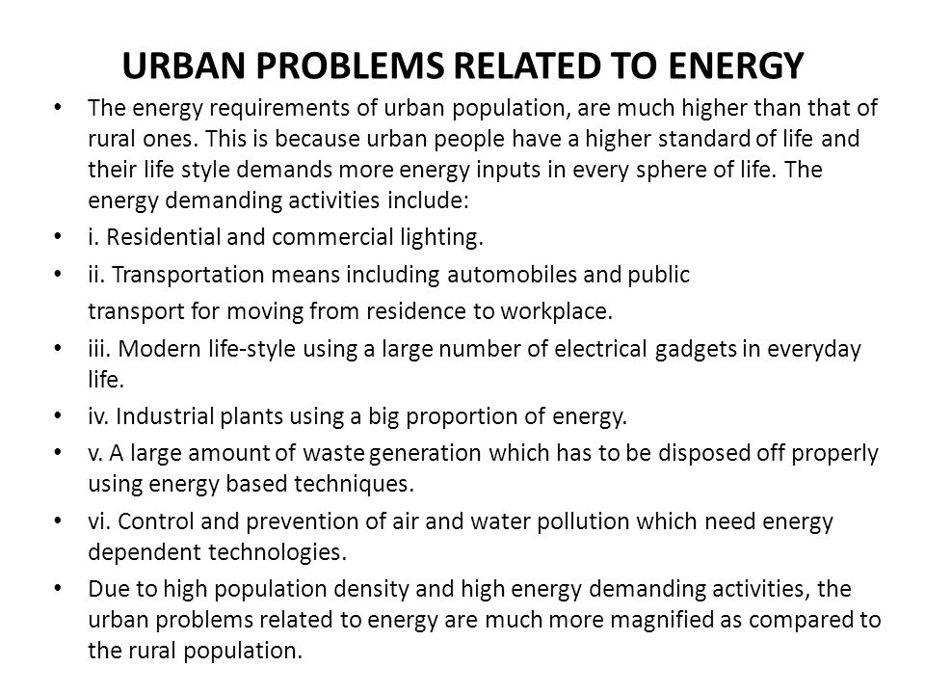

Slide 37
Methods for conservation of natural resource, and control
Establishment of organizations.
Create Act/Rules
Public Awareness
Use of 5R System
Use of scientific methods and Technology.
Follow the Disaster Management system.

Slide 38
Role of an Individual in Conservation of Natural Resources
Use recyclable resources like reuse paper page and encourage recycling.
Use alternative energy sources such as solar energy for domestic heating
Make equitable use of water for personal and domestic purposes.
Through better use and maintenance of non-maintainable resource.
Prefer to use renewable and non-conventional energy sources.

Slide 39
Important Web Links
http://ecoursesonline.iasri.res.in/mod/page/view.php?id=89590
https://www.ugc.ac.in/oldpdf/modelcurriculum/Chapter2.pdf
https://www.youtube.com/watch?v=1kUE0BZtTRc
https://study.com/academy/lesson/renewable-non-renewable-resources-definition-differences.html
https://video.nationalgeographic.com/video/00000144-0a2c-d3cb-a96c-7b2d805d0000

Slide 40
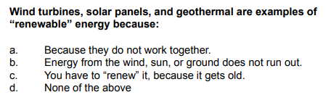

Slide 41
Acknowledgment
Some images, animation, and material have been taken from the following sources:
Textbooks: PERSPECTIVE IN ENVIRONMENTAL STUDIES by ANUBHA KAUSHIK, C P KAUSHIK, NEW AGE INTERNATIONAL PUBLISHERS
References Book: TEXTBOOK OF ENVIRONMENTAL STUDIES by D. DAVE AND S. S. KATEWA, CENGAGE LEARNING
3 All slides can be used for reading purpose only

